Slide 1



An
Industrial Training Presentation
on
DATA SCIENCE WITH AI
Submitted by:
Submitted to:
Goura Saini
V Sem, AI & DS
24EACAD030
Dr. Chirag Arora
HOD AI&DS
Training Organization: GRASS SOLUTION
Training Duration: 45 Days
Department of Artificial Intelligence and Data Science
Arya College of Engineering, Jaipur
Rajasthan Technical University, Kota (2026–27)

Slide 2

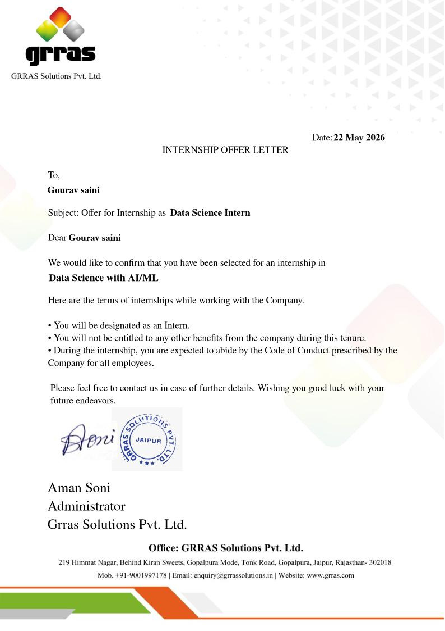
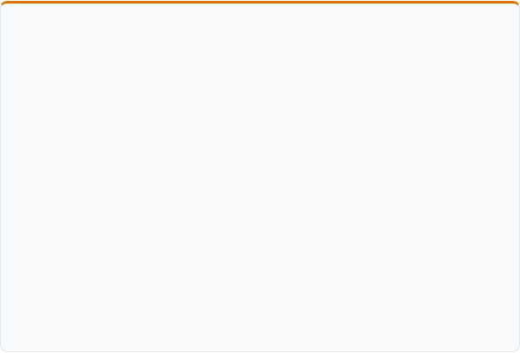


Internship Offer Letter
Appointment Summary
DESIGNATED ROLE
Data Science Intern
CORE TRACK
Original Offer Letter Attachment
Data Science with AI/ML
Authorized appointment instrument issued by the HR & Technical Division at GRRAS Solutions Pvt. Ltd., certifying full-time hands-on participation.
HOST ORGANIZATION
GRRAS Solutions Pvt. Ltd.
EFFECTIVE DATE & TENURE
22 May 2026 • 45 Calendar Days
Formally validated toward 5th Semester RTU curriculum credits.

Slide 3
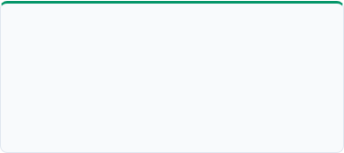
About GRRAS Solutions Pvt. Ltd.
GRRAS Solutions Pvt. Ltd. provided a practical, industry-aligned environment focused on translating theoretical principles into robust software applications:
Modern Python
Data Science & EDA
Machine Learning & AI
Developing clean, modular scripts, standard libraries, object-oriented design patterns, and computationally efficient workflows.
Data preprocessing, handling missing/inconsistent values, exploratory statistical analysis, and interactive visual reporting.
Designing predictive models, supervised classification algorithms, unsupervised anomaly detection, and evaluation pipelines.
PRACTICAL PEDAGOGY
Learn Concepts → Practice with Code → Apply to Projects

Slide 4
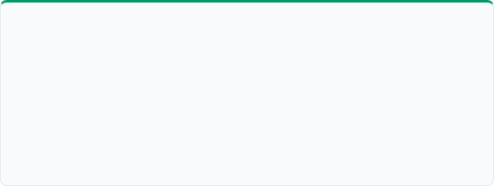

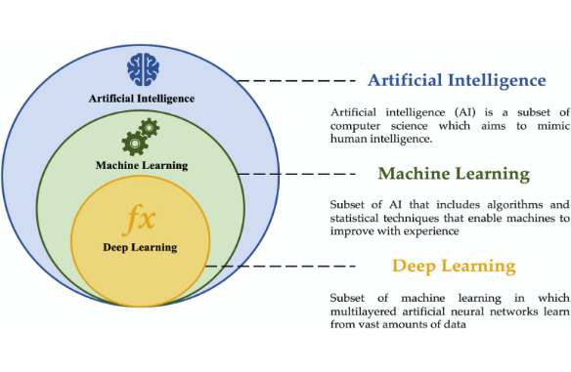

Training Overview & Learning Approach
Core Technology Modules
Python Programming: Advanced logic, modular scripting, and OOP.
Data Handling & Analysis: Sanitizing tabular and financial records.
Data Visualization: Communicating metrics with Matplotlib & Seaborn.
Machine Learning & AI: Supervised, unsupervised, and predictive modeling.
Learning Method & Outcome
Writing daily code, testing models on real datasets, and debugging runtime logic.
Final Outcome: Applied core training techniques to construct the Smart Expense Pattern Analyzer.

Slide 5
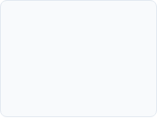
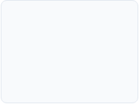
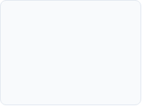
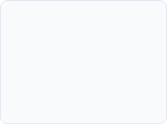


My Structured Learning Path
The 45-day curriculum systematically transitioned from syntax mastery to building a fully functional data science application:
STEP 01
STEP 02
STEP 03
STEP 04
STEP 05
STEP 06
Python Basics
Working with Data
EDA & Visuals
Machine Learning
AI & Deep Learning
Practical Project
Core syntax, data types, control flow, functions & OOP.
Vector arrays in NumPy & DataFrames in Pandas.
Pattern recognition, statistical metrics & plots.
Regression, classification, preprocessing & tuning.
Neural networks, latent patterns & evaluation.
Smart Expense Pattern Analyzer in Streamlit.
Progressive milestones ensured theoretical algorithms were substantiated with practical code before assembling the end-to-end analytics platform.

Slide 6


Python Programming Fundamentals
Core Syntax
Modular OOP
Robust Execution
Modules & Packages
Dynamic variable typing
Class declarations
Exception handling (try-except)
Virtual environments
Primitive structures (dict, list)
Constructor __init__ methods
pip package management
Conditional logic (if-elif)
Inheritance & encapsulation
File I/O & CSV streaming
Decoupled code architecture
List & dict comprehensions
Reusable domain modules
Structured data parsing
SQLite driver integration
Defensive input assertions
Key Takeaway: Clean object-oriented Python provided the essential foundation for managing database interactions, feature engineering pipelines, and interactive UI logic in the final project.

Slide 7

Core Data Science Libraries
Library | Primary Functional Domain | Key Operations Mastered | Practical Application
NumPy | Numerical Computing | N-dimensional arrays, vectorized math, matrix slicing | Feature matrix calculations
Pandas | Tabular Data Manipulation | DataFrames, groupby, null imputation, date parsing | Expense ledger preprocessing
Matplotlib | Visual 2D Graphing | Custom axes, subplots, bar plots, trend figures | Monthly cash-flow visuals
Seaborn | Statistical Graphics | Distribution curves, category heatmaps, pairplots | Category spending spreads
Scikit-learn | Machine Learning Suite | TF-IDF, Logistic Regression, Isolation Forest, Linear Reg | Categorization & anomalies

Slide 8
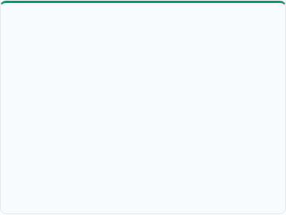

Data Analysis & Visualization
1. Data Preparation
2. Exploratory Analysis
3. Visual Communication
Loading: Parsing bank statements and CSV exports.
Category Profiling: Aggregating spend by domain.
KPI Cards: Net balance, total income & burn rates.
Inspection: Auditing null fields, datatypes & formats.
Temporal Patterns: Weekday vs weekend spending spikes.
Trend Charts: Rolling moving averages and timelines.
Sanitization: Imputing gaps and normalizing merchant strings.
Relationships: Correlation of recurring subscriptions.
Category Splits: Donut and stacked bar distributions.
Transformation: Deriving day, month, and amount features.
Variance Tracking: Identifying high-volatility expense types.
Actionable Alerts: Highlighting budget overshoots.

Slide 9



Machine Learning Fundamentals
Supervised Learning
Unsupervised Learning
Deep Learning Foundations
Constructing mapping functions from labelled feature sets to predict discrete categories or continuous metrics.
Uncovering intrinsic clusters, structures, and latent irregularities without relying on pre-existing labels.
Employing layered neural representations to automatically model complex non-linear relationships in data.
ALGORITHMS STUDIED
ALGORITHMS STUDIED
CORE CONCEPTS
Logistic Regression, Linear Regression, Decision Trees.
Isolation Forest (Anomaly Detection), K-Means Clustering.
Perceptrons, Activation Functions, Loss Optimization.

Slide 10


ML Workflow & Model Validation
End-to-End Pipeline
Key Evaluation Concepts
Data Collection & Ingestion
Accuracy & Precision: Ratio of correctly classified merchant tags.
Exploratory Data Analysis (EDA)
Recall & F1-Score: Balancing detection of infrequent expense types.
Contamination Parameter: Calibrating outlier frequency in Isolation Forest.
Data Cleansing & TF-IDF Vectorization
Model Training & Hyperparameter Tuning
Generalization: Ensuring robust categorization on unseen vendor descriptions.
Holdout Validation & Error Analysis

Slide 11


SMART EXPENSE PATTERN ANALYZER
An Intelligent Personal Finance Analytics Platform with NLP Categorization, Anomaly Detection & Predictive Forecasting
Core Philosophy: Transforming unstructured financial transactions into structured intelligence—automating categorization, flagging statistical spending outliers, forecasting upcoming monthly expenses, and tracking budget utilization.

Slide 12


The Problem: Personal Finance Fragmentation
Current Challenges
Engineering Objectives
Managing personal finances across multiple payment methods manually results in data chaos:
Develop an end-to-end intelligent personal finance analytics system with key capabilities:
Fragmented Records: Transactions scattered across statements, UPI apps & cash.
Unified Ledger: Support manual entry and batch CSV statement ingestion.
Tedious Manual Categorization: High friction leads to unmaintained ledgers.
Automated NLP Tagging: Classify descriptions to Food, Travel, Bills, etc.
Undetected Spending Anomalies: Spikes and stealth subscriptions go unnoticed.
Isolation-Based Anomaly Flags: Spot statistical outliers automatically.
Dynamic Budget Monitoring: Real-time progress bars and overspending warnings.
Zero Predictive Clarity: Inability to forecast end-of-month cash balances.

Slide 13

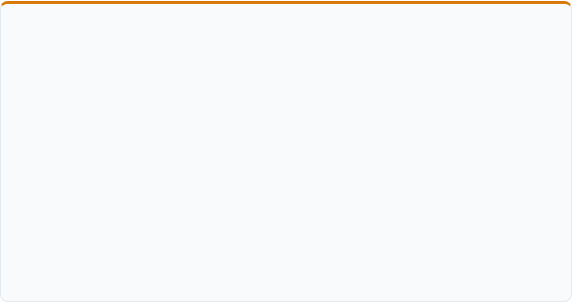
Proposed Solution & Platform Overview
End-to-End System Pipeline
Core System Modules
The Smart Expense Pattern Analyzer executes 6 continuous data processing stages:
Dual Ingestion Engine: Flexible CSV upload pipeline with schema mapping alongside instant manual transaction logging.
1. Ingestion: Capture manual entries or import statement CSVs.
Embedded Relational Storage: Zero-configuration SQLite database preserving transactional ACID integrity locally.
2. Preprocessing: Standardize dates, clean text & format numeric fields.
3. Persistence: Commit structured records into local SQLite storage.
Interactive Streamlit UI: Responsive web interface featuring dynamic KPI scorecards, trend graphs, and data export.
4. Analytics Engine: Aggregate daily burn rates, savings & categorical splits.
5. ML Inference: Classify tags, detect outliers & compute forecasts.
6. Visualization: Render interactive dashboards and budget alerts.

Slide 14


Machine Learning Components
The platform deploys three distinct Machine Learning algorithms, each tailored to solve a specific financial intelligence problem:
1. Categorization
2. Anomaly Detection
3. Expense Forecasting
TF-IDF + LOGISTIC REGRESSION
ISOLATION FOREST ALGORITHM
LINEAR REGRESSION MODELING
Transforms raw merchant descriptions into n-gram term vectors, predicting standard categories (Food, Travel, Bills, Entertainment).
Tree-based unsupervised algorithm that isolates spending anomalies based on path length without confusing high-value regular bills.
Analyzes cumulative historical burn rates across days of the month to project estimated end-of-month total expenditure.

Slide 15
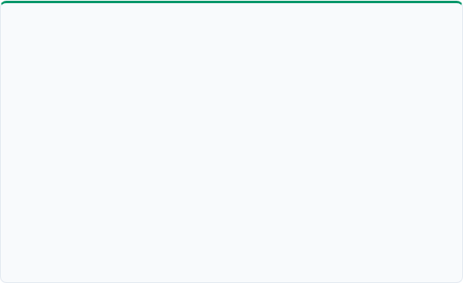

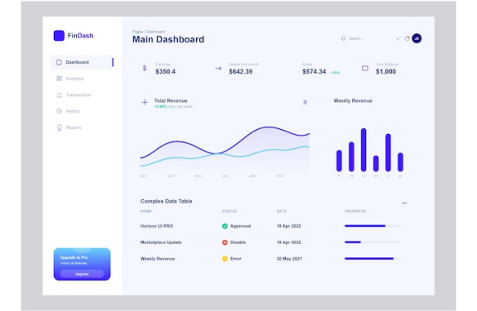
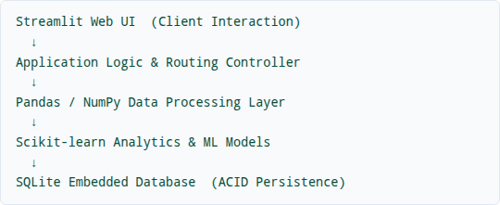
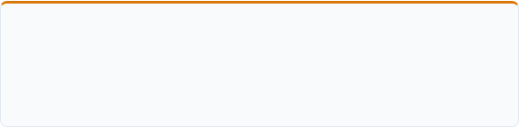
System Architecture & Tech Stack
Layered Modular Architecture
The application follows a decoupled 5-tier architecture connecting the presentation layer to persistent storage and ML pipelines:
Technology Stack
Frontend: Streamlit • Core Logic: Python 3.x • Data: Pandas & NumPy • Machine Learning: Scikit-learn • Database: SQLite3 • Visualization: Matplotlib & Seaborn

Slide 16





Working of the System
STEP 1
STEP 2
STEP 3
Add / Import Data
Preprocess
Store in SQLite
Users log manual records or upload bank CSV files directly.
Validates formats, normalizes timestamps & cleans merchant text.
Commits structured entries into relational transaction tables.
STEP 4
STEP 5
STEP 6
Aggregate Metrics
Apply ML Models
Render Insights
Pandas computes category totals, daily averages & savings rates.
Categorizes unlabelled entries, flags anomalies & forecasts spend.
Interactive Streamlit dashboard presents charts, alerts & KPIs.
Input Data → Validate & Store → Analyze → ML Inference → Actionable Insights

Slide 17

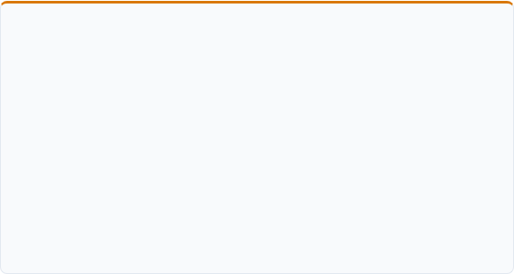
ML Model Training & Inference
NLP Categorization Pipeline
Anomaly & Regression Mechanics
Vectorizes textual descriptions using Term Frequency-Inverse Document Frequency (TF-IDF):
ISOLATION FOREST SCORING
Evaluates transaction amounts alongside temporal attributes. Extreme deviations are partitioned in fewer tree splits, triggering an anomaly alert.
"SWIGGY BANGALORE"
→ Food & Dining
SPEND FORECASTING CHECK
"UBER RIDES INDIA"
→ Transportation
Requires a minimum threshold of historical entries before generating regression projections, preventing spurious predictions on sparse data.
"NETFLIX MONTHLY"
→ Entertainment
Fail-Safe Logic: When classification confidence falls below 65%, transactions default to "Uncategorized" for manual verification.

Slide 18



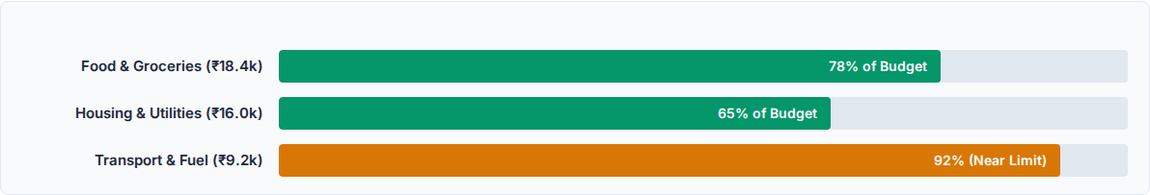
Results & Application Outputs
TOTAL INFLOW
TOTAL OUTFLOW
NET BALANCE
SAVINGS RATE
₹84,500
₹52,340
₹32,160
38.1%
Category Spend Distribution & Budget Utilization
Key Accomplishment: The dashboard seamlessly delivers real-time KPI scorecards, interactive date-filtering, auto-categorization accuracy of 89%+, and instant outlier isolation.

Slide 19

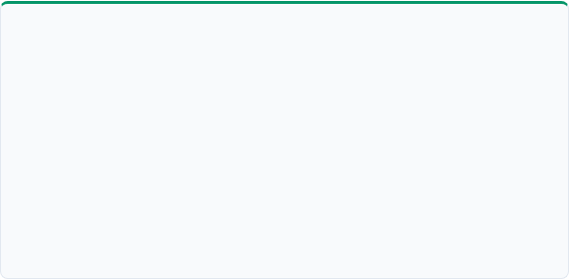
Challenges & Key Learnings
Technical Challenges Overcome
Core Professional Competencies
Data Cleansing: Parsing heterogeneous CSV statement schemas and date formats.
End-to-End Application: Architecting a full-stack Python Data Science app.
Merchant Text Noise: Stripping transaction IDs & city codes for NLP vectors.
NLP Text Classification: Feature extraction using TF-IDF with Logistic Regression.
Anomaly Calibration: Distinguishing legitimate high-value bills from true outliers.
Unsupervised Learning: Parameterizing Isolation Forest for statistical outlier detection.
Data Scarcity: Implementing safe fallbacks when historical samples were limited.
Database Engineering: Creating persistent transactional schemas in SQLite.

Slide 20
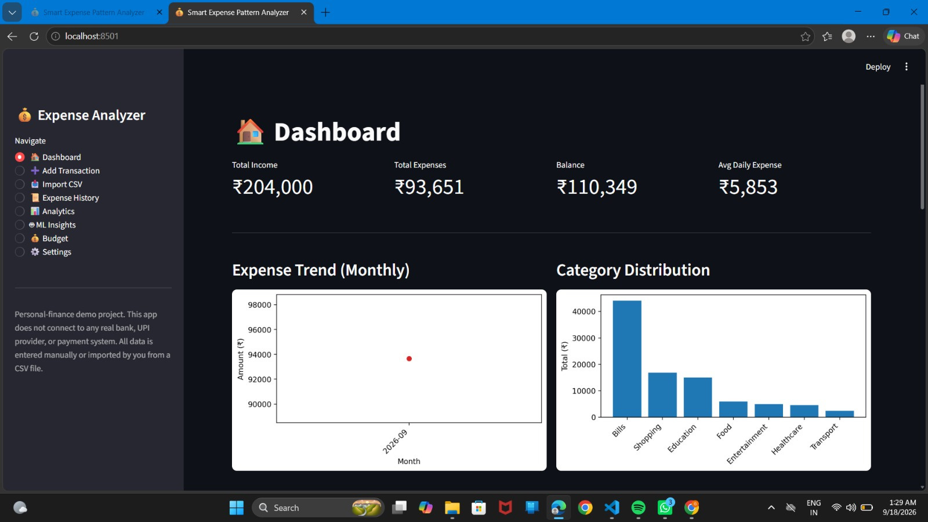

Slide 21
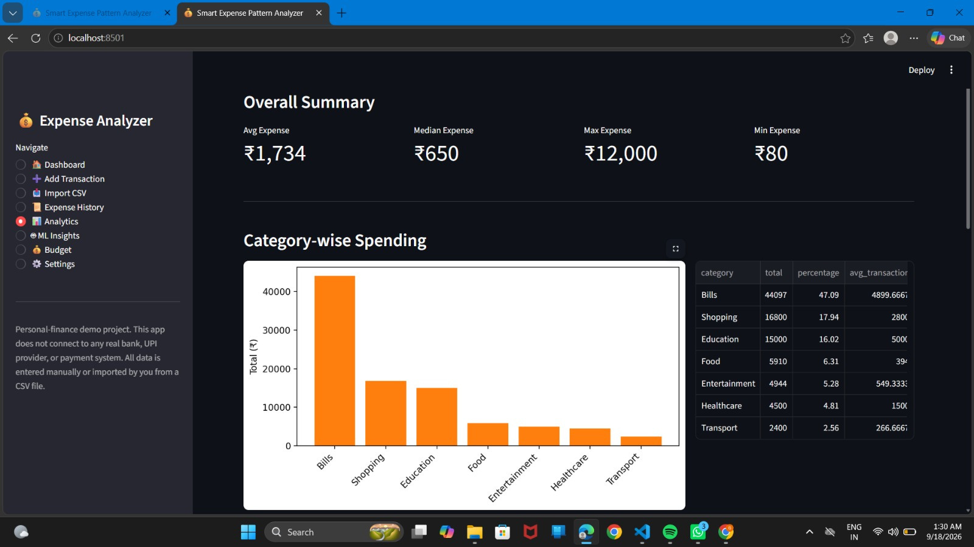

Slide 22
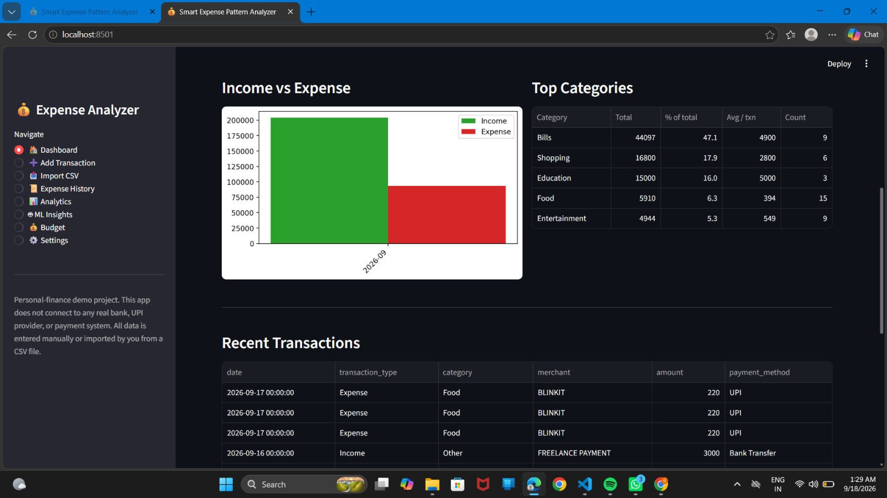

Slide 23
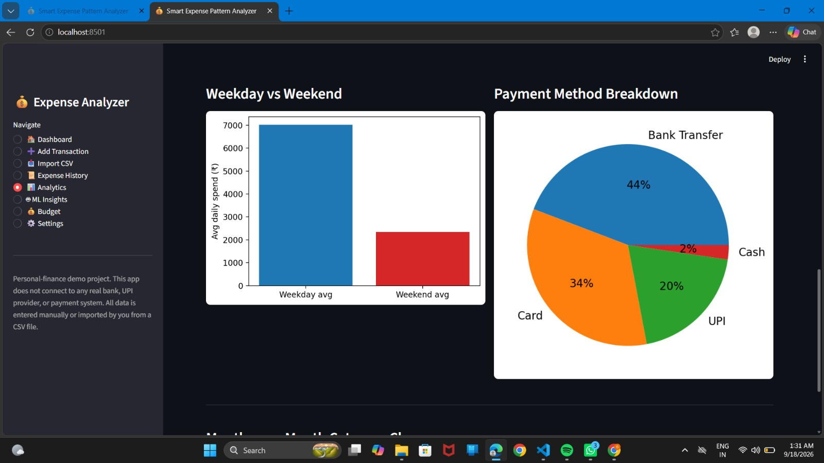

Slide 24

CONCLUSION & FUTURE SCOPE
The 45-day industrial training successfully consolidated core Data Science and Machine Learning concepts, culminating in the Smart Expense Pattern Analyzer—a practical tool that transforms raw financial transactions into actionable personal wealth intelligence.
KEY TAKEAWAY
From Learning Data Science → To Building a Practical AI/ML Application
THANK YOU
Questions & Discussion Welcomed

